Slide 1

Assignment; Tuples with dictionaries; Looping
Python Programming | Loops, string, files, list, dictionaries and tuples
Course: Python Programming | Chapter: Loops, string, files, list, dictionaries and tuples | Program: Bachelor of Computer Science and Engineering
DISCOVER · LEARN · EMPOWER
Notes:
Welcome everyone to today's session on Python data structures. We will focus specifically on the powerful combination of tuples and dictionaries within loop structures. This assignment will solidify your understanding of immutable keys and efficient data retrieval.

Slide 2
Course Outcomes
SLIDE 2 / 14
Course Outcome
CO | BT LEVEL | DESCRIPTION
CO1 | BT1 | Understand the syntax, control structures, and basic constructs of Python programming language
CO2 | BT3 | Apply functions, modules, and exception handling for modular program development
CO3 | BT3 | Implement data structures including lists, tuples, dictionaries, and sets for efficient data processing
CO4 | BT4 | Analyze and manipulate files, strings, and perform data handling operations
CO5 | BT5 | Design and develop real-world applications integrating multiple Python concepts
Chandigarh University
2 / 14
Notes:
Today's lecture directly addresses three specific course outcomes. You will apply modular development principles while implementing complex data structures. Furthermore, you will analyze how to manipulate these structures for efficient data handling operations.

Slide 3
Learning Objectives
SLIDE 3 / 14
Learning Outcomes
1
Analyze the role of tuples as immutable dictionary keys in Python
2
Apply nested loops to traverse complex dictionary structures efficiently
3
Evaluate common pitfalls when modifying dictionary values during iteration
4
Construct robust assignment logic using tuple unpacking within loops
5
Demonstrate error handling for invalid data types in dictionary lookups
Chandigarh University
3 / 14
Notes:
By the end of this session, you will be able to analyze why tuples are preferred for dictionary keys. You will apply nested loops to traverse complex data and evaluate common pitfalls like modifying dictionaries during iteration. Finally, you will construct robust assignment logic using tuple unpacking.

Slide 4
Lecture
SLIDE 4 / 14
Tuples as Dictionary Keys
1
Dictionaries require keys to be hashable and immutable objects
2
Tuples are immutable sequences that satisfy the hashable requirement
3
Lists cannot serve as keys because they are mutable and unhashable
4
Nested tuples like (1, 2) create unique composite keys for data
5
Hashing a tuple depends on the hash values of its elements
6
Using tuples allows grouping multiple attributes into a single unique ID
7
Immutable keys prevent accidental modification of the dictionary structure
Chandigarh University
4 / 14
Notes:
Why do we use tuples? Because dictionaries need immutable keys. If you try to use a list, Python raises a TypeError. A tuple like (1, 2) is hashable, allowing us to create unique composite keys. This is crucial for maintaining data integrity during assignments.

Slide 5
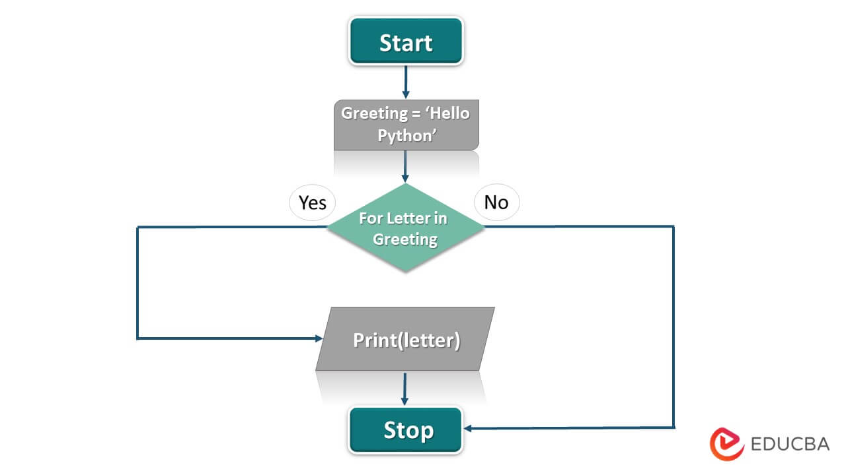
Lecture
SLIDE 5 / 14
Looping Through Dictionary Items
SYNTAX
for key, value in my_dict.items() works efficiently
• The items() method returns a view of key-value pairs
• Tuple unpacking extracts keys and values directly in the loop
• Iterating by keys only requires the keys() method for access
• Iterating by values only requires the values() method for access
• Direct iteration over the dictionary yields only the keys
• Unpacking reduces code verbosity and improves readability significantly
Source: cdn.educba.com
Chandigarh University
5 / 14
Notes:
When looping, always use the items() method to get both keys and values. You can unpack these directly into variables like key and value. This approach is cleaner than accessing the dictionary repeatedly inside the loop. It makes your code more readable and efficient.

Slide 6
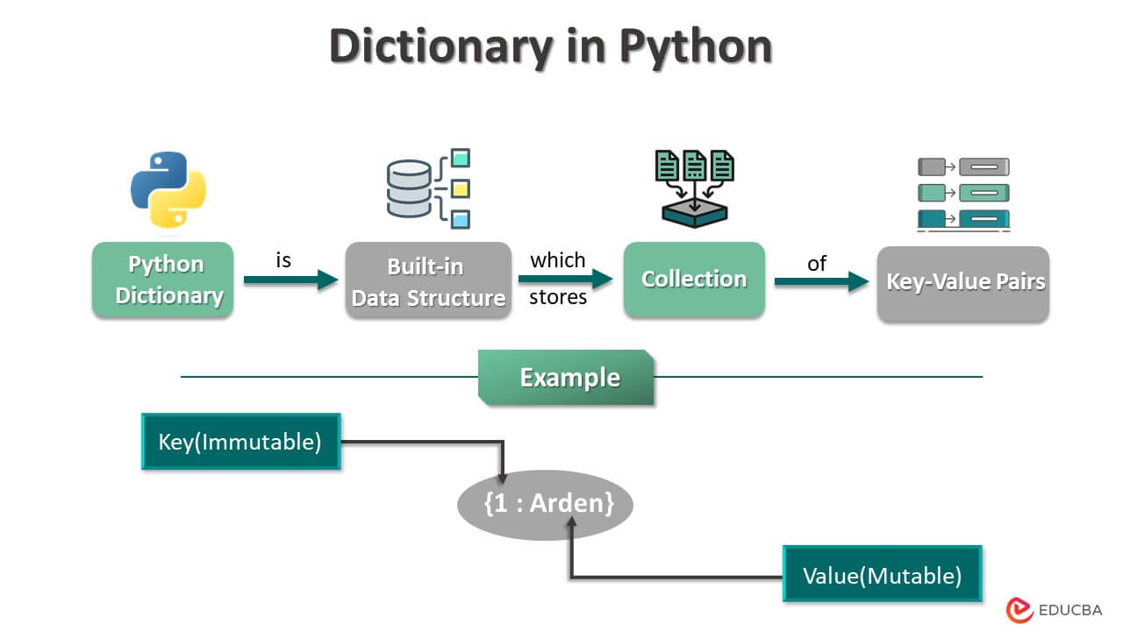
Lecture
SLIDE 6 / 14
Assignment Logic with Tuples
GOVERNING EQUATION
Use the syntax dict[tuple_key] = new_value for updates
1
Assignments update values associated with specific tuple keys
2
Check if a key exists before assignment to avoid overwriting
3
The get() method provides a default value for missing keys
4
Assignment logic must handle type errors for invalid tuple formats
5
Complex assignments can involve arithmetic on existing tuple values
6
Immutable keys ensure the dictionary structure remains stable during updates
Source: cdn.educba.com
Chandigarh University
6 / 14
Notes:
Assignment logic involves updating values associated with specific tuple keys. You use the standard syntax dict[key] = value. Always check if the key exists first to avoid accidental overwrites. The get() method is useful for providing default values when keys are missing.

Slide 7
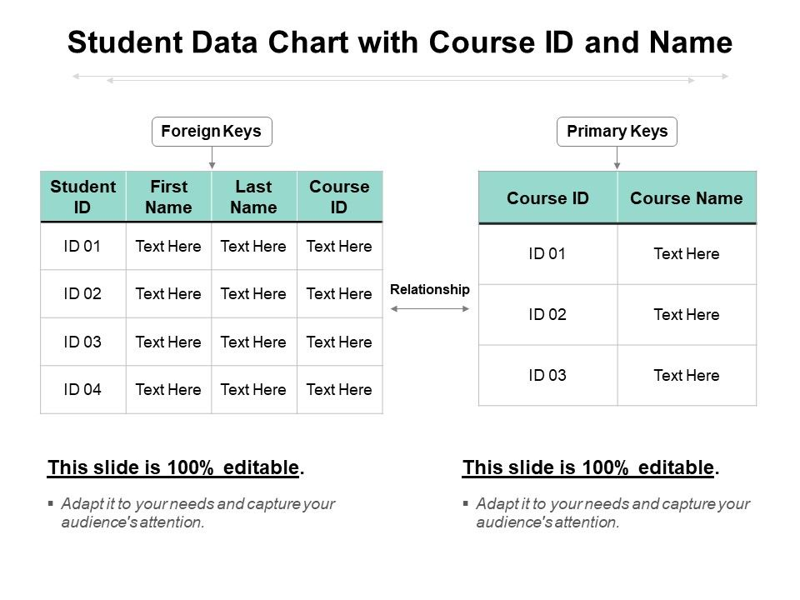
Worked Example
SLIDE 7 / 14
Student Records
GOVERNING EQUATION
Example: grades = {(101, 'CS'): 85, (102, 'CS'): 90}
1
Create a dictionary with tuple keys (student_id, course_code)
2
Assign grades to specific student-course combinations using tuples
3
Loop through items to calculate the average grade for a course
4
Sum all grades and divide by the count of students enrolled
5
Output the result formatted to two decimal places for clarity
6
This structure prevents duplicate entries for the same student-course pair
Source: www.slidegeeks.com
Chandigarh University
7 / 14
Notes:
Consider a student records system where keys are (student_id, course_code). We assign grades like 85 or 90 to these tuple keys. We then loop through to calculate the average grade for a specific course. This ensures no duplicate entries for the same student in the same course.

Slide 8
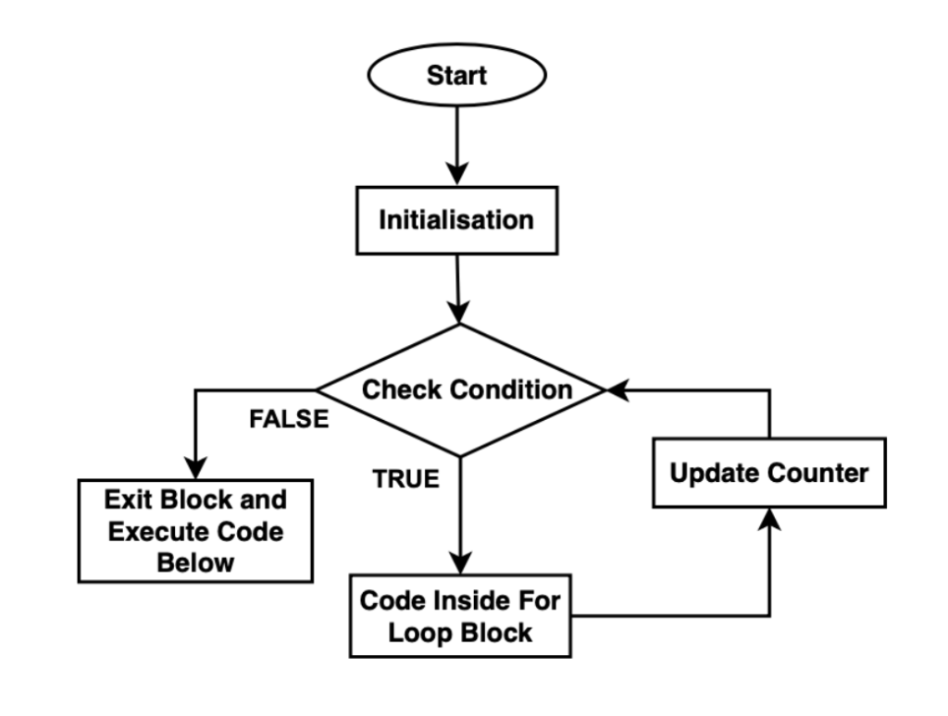
Worked Example
SLIDE 8 / 14
Calculation Logic
GOVERNING EQUATION
Calculate average: average = sum / counter if counter > 0
LOOP
for (sid, course), grade in records.items():
PRINT THE RESULT
Average grade for CS is 87.50
• Initialize a sum variable to zero before starting the loop
• Initialize a counter variable to track the number of entries
• If course equals 'CS', add grade to sum and increment counter
• Handle division by zero if no students are enrolled in the course
Source: static.takeuforward.org
Chandigarh University
8 / 14
Notes:
Let's trace the calculation logic. We initialize sum and counter to zero. Inside the loop, we check if the course is 'CS'. If true, we add the grade to the sum and increment the counter. Finally, we divide the sum by the counter to get the average. This handles the data processing efficiently.

Slide 9

Common Pitfall
SLIDE 9 / 14
Modifying During Loop
1
Do not add or remove keys while iterating over the dictionary
2
Modifying the dictionary size raises a RuntimeError during iteration
3
Create a list of keys to modify safely outside the loop
4
Use list comprehension to filter or transform keys before updating
5
Iterating over a copy of items() prevents runtime errors
6
Safe modification ensures the program does not crash unexpectedly
7
Always validate data integrity before performing structural changes
Source: static.vecteezy.com
Chandigarh University
9 / 14
Notes:
A critical pitfall is modifying the dictionary while iterating over it. This raises a RuntimeError because the size changes. To fix this, create a list of keys to modify or iterate over a copy of the items. This ensures your program remains stable and does not crash.

Slide 10
Common Pitfall
SLIDE 10 / 14
Unhashable Types
1
Using a list as a dictionary key causes a TypeError immediately
2
Lists are mutable and therefore cannot be hashed for dictionary keys
3
Convert lists to tuples before using them as dictionary keys
4
Ensure all elements within the tuple are also hashable types
5
Nested lists inside tuples will also cause hashing errors
6
Validate input data types before constructing the dictionary structure
7
Use isinstance checks to verify tuple types before assignment
Chandigarh University
10 / 14
Notes:
Another common error is using a list as a key. This causes a TypeError because lists are mutable. You must convert lists to tuples before using them as keys. Also, ensure all elements inside the tuple are hashable. Nested lists will also cause errors, so validate your input data types.

Slide 11
Lecture
SLIDE 11 / 14
Nested Loops for Complex Data
1
Use nested loops to process multi-dimensional dictionary structures
2
Outer loop iterates over primary keys like department IDs
3
Inner loop iterates over secondary keys like employee IDs
4
Combine tuple keys to represent hierarchical data relationships
5
Accumulate totals across multiple levels of the data hierarchy
6
Break out of loops early if a specific condition is met
7
Use flags to control the flow of nested iteration logic
Chandigarh University
11 / 14
Notes:
For complex data, use nested loops to process multi-dimensional structures. The outer loop might iterate over departments, while the inner loop handles employees. You can combine tuple keys to represent these hierarchical relationships. This allows you to accumulate totals across multiple levels of the data hierarchy effectively.

Slide 12
Lecture
SLIDE 12 / 14
Exception Handling in Loops
1
Wrap dictionary access in try-except blocks for safety
2
Catch KeyError exceptions when a tuple key is missing
3
Catch TypeError exceptions when data types are incorrect
4
Provide user-friendly error messages for debugging purposes
5
Use the else clause to execute code if no exception occurs
6
Log errors to a file for later analysis and troubleshooting
7
Ensure the program continues running after handling exceptions
Chandigarh University
12 / 14
Notes:
Always wrap dictionary access in try-except blocks for safety. Catch KeyError exceptions when a tuple key is missing. You should also catch TypeError exceptions for incorrect data types. Provide user-friendly error messages and log errors to a file for later analysis. This ensures the program continues running smoothly.

Slide 13
Lecture
SLIDE 13 / 14
Key Takeaways
1
Tuples are immutable and serve as valid dictionary keys
2
Use items() method with tuple unpacking for efficient looping
3
Never modify a dictionary while iterating over it directly
4
Convert lists to tuples to avoid unhashable type errors
5
Implement exception handling to manage missing or invalid keys
Chandigarh University
13 / 14
Notes:
To summarize, remember that tuples are immutable and serve as valid dictionary keys. Use the items() method with tuple unpacking for efficient looping. Never modify a dictionary while iterating over it directly. Convert lists to tuples to avoid unhashable type errors. Finally, implement exception handling to manage missing or invalid keys.

Slide 14
Lecture
SLIDE 14 / 14
References
PYTHON
A Practical Learning Approach, 1st Edition — T.S. Murugesh, Shriram K. Vasudevan, Sini Raj Pulari
• Learning Python, 6th Edition — Mark Lutz
• Starting Out with Python, Global Edition, 6th Edition — Tony Gaddis
• Introduction to Python Programming and Data Structures, 3rd Edition — Y. Daniel Liang
Chandigarh University
14 / 14
Notes:
These four books provide comprehensive coverage of Python programming and data structures. Mark Lutz's book offers deep insights into Python internals. Tony Gaddis provides excellent beginner-friendly examples. Y. Daniel Liang and the team at Chandigarh University offer practical approaches to data handling.

